Slide 1
Chemistry – Oct 14, 2019
P3 Challenge-
Convert 1.08 atm to kPa using the factor label method
Objective –
Boyle’s Law
Charles’ Law
Gay-Lussac’s Law
Avogadro's Law
Gas Law Mathematics
Hand in Separation Lab Report
Get out PT unit WS for HMK check

Slide 2
Variables for gases
There are four variables that can be measured and describe a gas:
Pressure, P
Volume, V
Temperature, T
Moles of gas, n
If you know the measurements for all four of these variables you have a complete description of a sample of gas.
We will look at how these variables are related to one another.
How these relationships are justified by KMT
Then we will add mathematics.

Slide 3
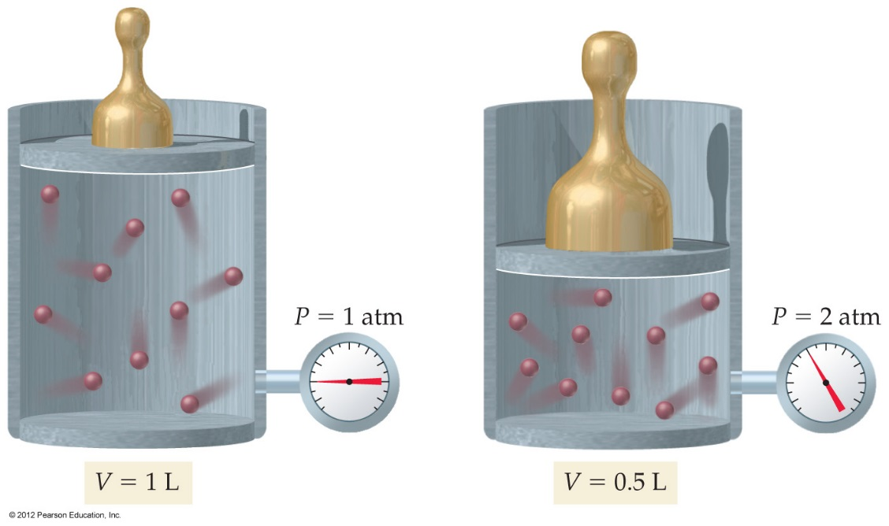
Boyle’s Law
Consider any given sample of gas in a compressible container.
As you compress the gas, what happens to the pressure of the gas?
Consider a cylinder with a piston attached
As mass increases, height decreases
As pressure increases, volume decreases

Slide 4
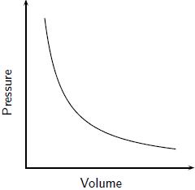
Boyle’s Law
You will find that pressure and volume are inversely proportional
Graph P vs V is a curve.
From KMT, Pressure is due to collisions of gas particles with the walls of the container.
If the container is flexible, as you compress a gas (V↓), more particles will hit the walls (P↑).
As you expand a gas (V↑)., fewer particles will hit the walls (P↓).

Slide 5
How to solve gas problems
Identify given information using units as your guide. Summarize in a table.
Determine what information is constant and mark with C for initial final and effect.
If both initial and final values are known, indicate the effect with an up or down arrow.
Determine the effect for the other variable and predict whether the missing information will be higher or lower than the given information.
 | P | T | V
Initial
Final
Effect

Slide 6
Gas Law Problem Diagrams
Method needed for each variable.
V – Size of box
P – size and boldness of arrow on top of box
T – Size of arrows on each particle of gas
n – number of particles

Slide 7
Boyle’s Law Problem
Ex: A cylinder with a moveable piston has an applied pressure of 4.0 atm and a volume of 6.0 L. Will the volume of the cylinder be greater or less than 6.0 L if the applied pressure is decreased to 1.0 atm at a constant temperature?
 | P | T | V
Initial
Final
Effect

Slide 8
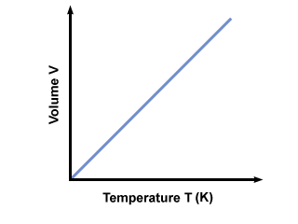
Charles’s Law
Generally, if temperature increases, then volume increases.
Specifically you will find they are directly proportional.
Graph is a straight line through the origin.
Note: Pressure is held constant and T is in Kelvin.
From KMT: higher Temp→ faster particles→ more collisions→ Larger volume

Slide 9
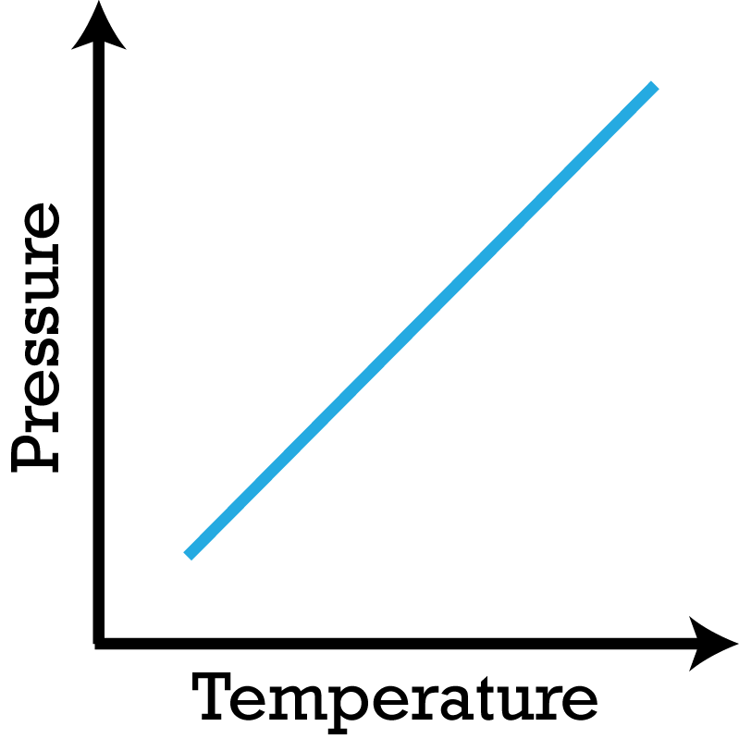
Gay-Lussac’s Law
Generally, if temperature increases, then pressure increases as we saw in the lab last time. (Note the similarity to Charles’ Law.)
Specifically you will find they are directly proportional.
Graph is a straight line through the origin.
Note: Volume is held constant and T is in Kelvin.
From KMT: higher Temp→ faster particles→ more forceful collisions→ Higher pressure

Slide 10
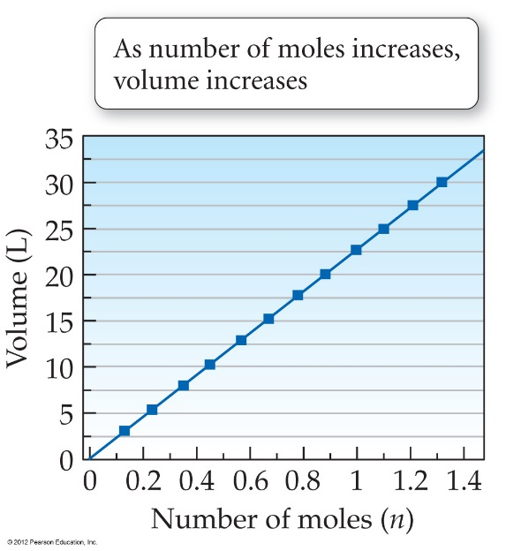
Avogadro’s Law
The amount /number of gas particles present in a sample is measured in terms of moles, n
When temperature and pressure are held constant, if the amount of gas is increased, the volume of the sample increases. (e.g. balloon)
Experiments show that this is a direct proportionality.
Graph is a straight line through the origin.
From KMT: If there are more particles added, the only way to have the same pressure at the same temperature is to increase the size of the vessel

Slide 11
Simple Gas laws Summary
Boyle’s Law – P V
Pressure increases, Volume decreases. Vice versa. T constant. (n constant)
Charles’ Law – T  V 
Temperature increases, Volume increases. Vice versa. P constant. (n constant)
Gay-Lussac’s Law – T  P
Temperature increases, Pressure increases, Vice versa. V constant. (n constant)
Avogadro’s Law - n  V 
Number of moles of gas increases, Volume increases. Vice versa. P and T constant.

Slide 12
Two possible options
Variables may be directly or indirectly related.
For direct variation, as one goes up, the other goes up. And if one goes down, the other goes down. X↑Y↑ and X↓Y↓ They are in sync.
For indirect variation, as one goes up, the other goes down. X↑Y↓ and X↓Y↑
For direct variation, the graph of X vs Y is a line:
For indirect variation, the graph is a curve:
Direct:
Indirect:

Slide 13
Mathematics of Gas Laws
For Boyles Law, P and V are inversely related so the equation can be used to solve.
For Charles Law, Gay-Lussac Law, and Avogadro’s Law are directly related so the equations you can use all take the same form:
Or Charles Law and Gay-Lussac can be combined to become a combined Law
Solve by cross multiplying.

Slide 14
Boyle’s Law Problem
Ex: A cylinder with a moveable piston has an applied pressure of 4.0 atm and a volume of 6.0 L. Will the volume of the cylinder be greater or less than 6.0 L if the applied pressure is decreased to 1.0 atm at a constant temperature?
What is the new volume?
 | P | T | V
Initial
Final
Effect

Slide 15
Sample Problem
Solve problems using the same strategy as Boyle’s Law
Make sure all temperatures are Kelvin!
Ex: A sample of gas has a volume of 2.80 L at an unknown temperature. When the sample is submerged in ice water at T = 0 ◦C, its volume decreases to 2.57 L. What was its initial temperature?
Always consider whether the answer you get from a gas problem makes sense qualitatively. Do values increase/decrease as expected?
 | P | T | V
Initial
Final
Effect

Slide 16
Gay-Lussac’s Law Problem
Solve problems using the same strategy as Charles’ Law
Make sure all temperatures are Kelvin!
Ex: A container of gas is initially at 0.500 atm and 25◦C. What will the pressure be at 125◦C?
Do values increase/decrease as expected?
 | P | T | V
Initial
Final
Effect

Slide 17
Exit Slip and Assignment
State Boyle’s Law.
What’s Due? (Pending assignments to complete.)
Gas Laws Worksheet
What’s Next? (How to prepare for the next day)
Energy, p38-45

